Slide 1
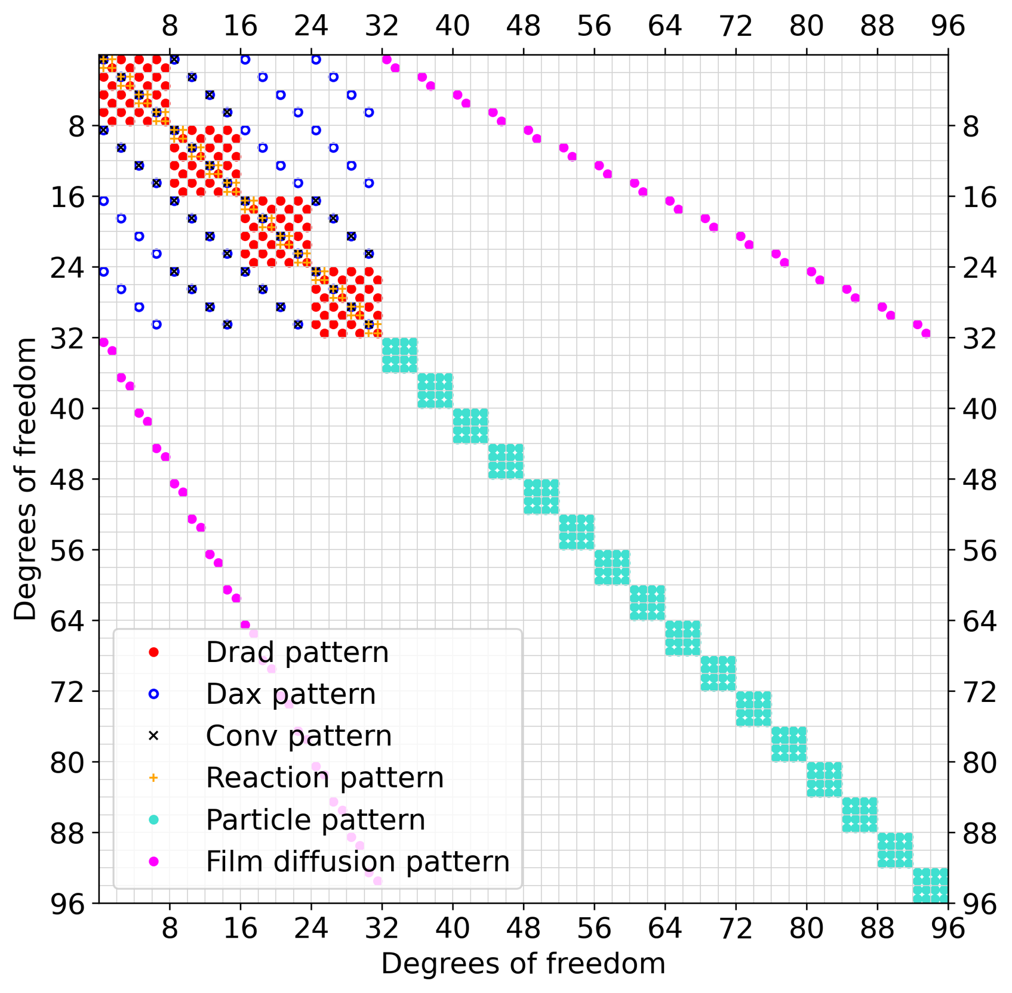
BULK ↔ BULK
Convection, Dispersion,
Reaction
BULK ↔ PARTICLE
Film Diffusion
BULK
PARTICLE ↔ BULK
Film Diffusion
PARTICLE ↔ PARTICLE
Particle transport
PARTICLE
BULK
PARTICLE

